Slide 1

Team Details
  Team name: Prakhar
  Team leader name: Omkar Lolage
  Problem Statement: Predictive Parking Space Marketplace

Slide 2



Brief about the idea
What if parking felt as effortless as booking a cab? Our app is a predictive parking marketplace that shows you where a spot will be free at your ETA, lets you pre‑book it with confidence, and auto‑handles payments - so you just drive, park, and go.
Powered by a spatiotemporal ML engine that forecasts bay-level availability at your ETA with calibrated confidence, fuses live signals (ETA, events, weather, sensors), and auto‑triggers backup swaps when risk rises.
How it works:
  Ingests live signals (inventory, ETA, events, weather) into a unified feature stream.
  Uses a spatiotemporal ML model to predict spot availability at arrival time with confidence bands.
  Ranks parking offers by distance, price, and success probability, with EV and accessibility filters built in.
  Lets users book guaranteed or lower-cost “smart hold” spots; automatically reserves a backup if confidence is low.
  Enables seamless entry via QR, NFC, or license plate, with guided navigation for smooth last-meter access.
  Handles payments automatically, pre-auth at booking, capture on exit with instant receipts and invoices.

Slide 3
Brief about the idea
What if parking felt as effortless as booking a cab? Our app is a predictive parking marketplace that shows you where a spot will be free at your ETA, lets you pre‑book it with confidence, and auto‑handles payments - so you just drive, park, and go.
Powered by a spatiotemporal ML engine that forecasts bay-level availability at your ETA with calibrated confidence, fuses live signals (ETA, events, weather, sensors), and auto‑triggers backup swaps when risk rises.
Why it works:
  Moves beyond guesswork with calibrated probabilities, showing users a trustworthy “chance of spot” instead of static pins.
  Smart backup-swap automatically switches to the best nearby option if the first isn’t ready, backed by an SLA to reduce failure anxiety.
  Demand steering through small time or price nudges smooths peaks, cutting cruising and improving availability.
  A continuous learning loop (arrivals, overstays, no-shows) refines predictions daily, boosting accuracy, utilization, and revenue.

Slide 4
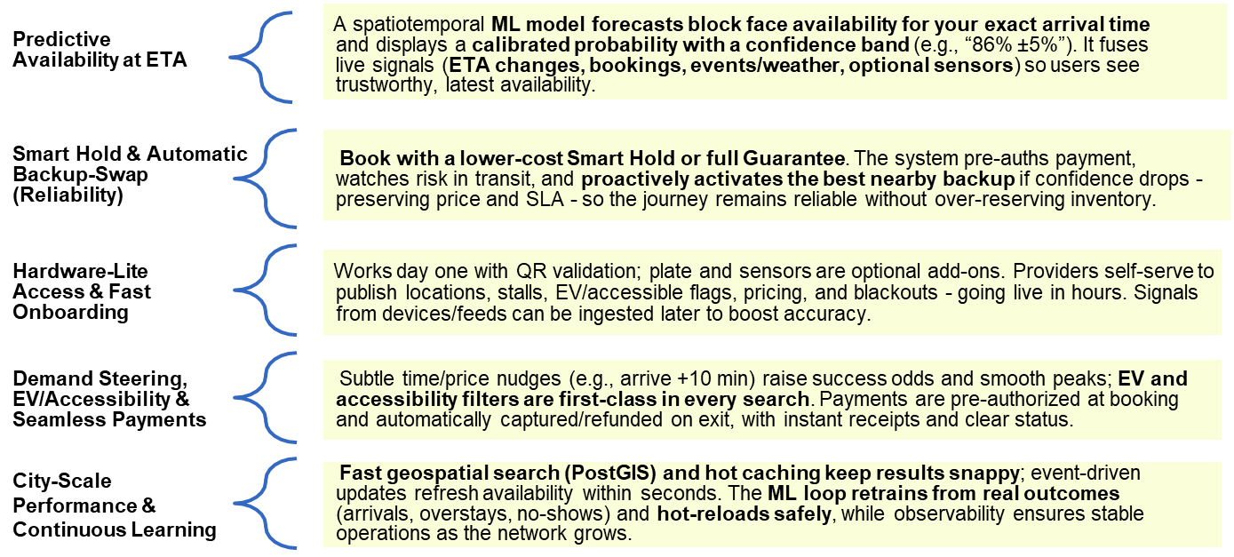
Opportunities – USP and “How It Solves” the problem

Slide 5
List of features offered by the solution
“Fast Search & Offers”
Real‑time discovery
Ranked nearby options with map + list, rich cards (price, distance, rules, EV/accessible), entrance info, and quick filters for time, price cap, and amenities.
“One‑Tap Booking & Payments”
Hold → confirm
Choose Guaranteed or Smart Hold, see clear price breakdown and policy, confirm with saved payment; pre‑auth status shown inline with friendly error recovery.
“Provider Console & Ops”
Self‑serve supply and insights
Onboard locations/stalls, set pricing/blackouts, monitor live sessions and bookings, and view utilization/revenue basics; changes reflect quickly in customer search.
“Session Control & Exit” Manage your stay
Live timer, extend stay, cost estimator, gentle overstay/grace alerts; end session to auto capture/refund and receive an itemized receipt instantly.
“Guided Arrival & Access”
Navigate and validate
Turn‑by‑turn to the correct entrance, arrival checklist, and hardware‑lite access via QR/NFC (plate entry fallback); bay/level guidance on success.
“Proactive Alerts & Support” Stay informed end‑to‑end
Clear notifications for confirmations, swap notices, reminders, and extension prompts; instant receipts and quick help.

Slide 6
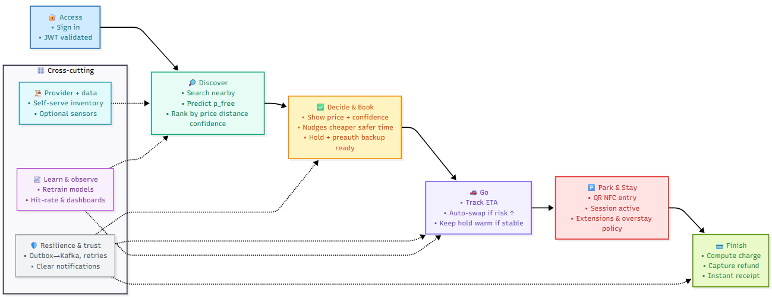
Process flow diagram or Use-case diagram

Slide 7
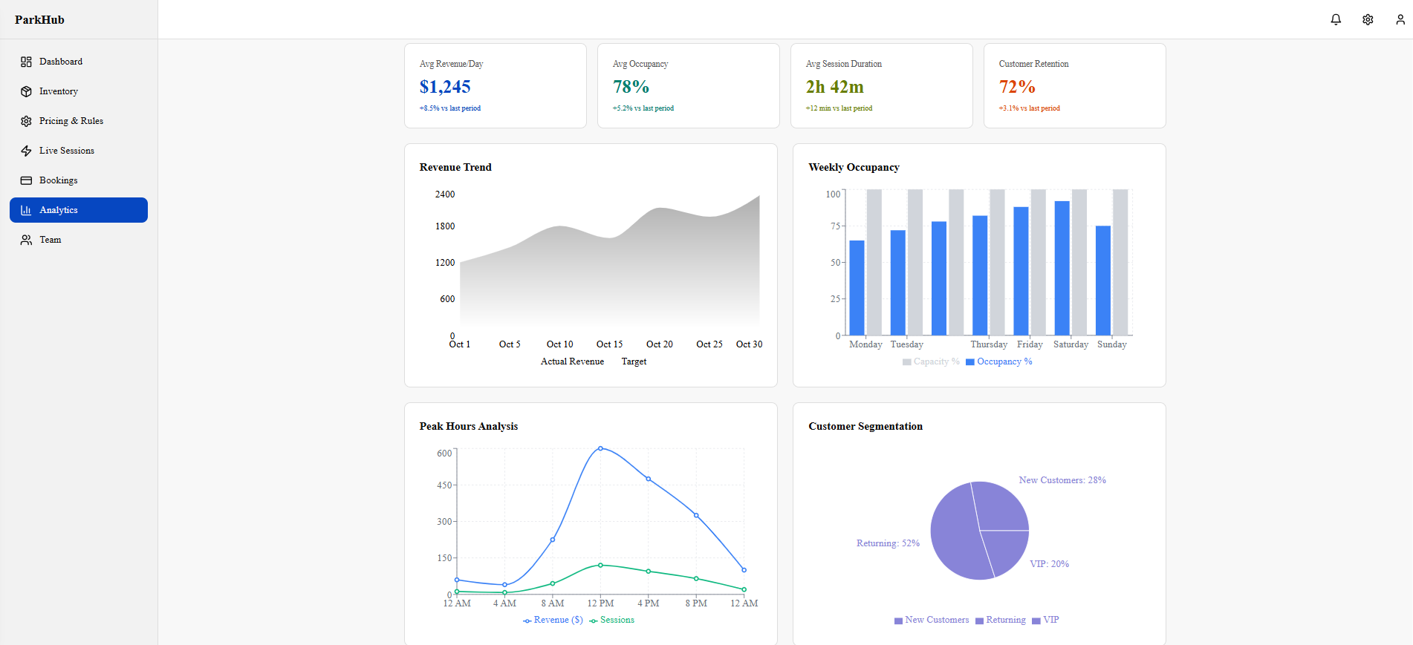
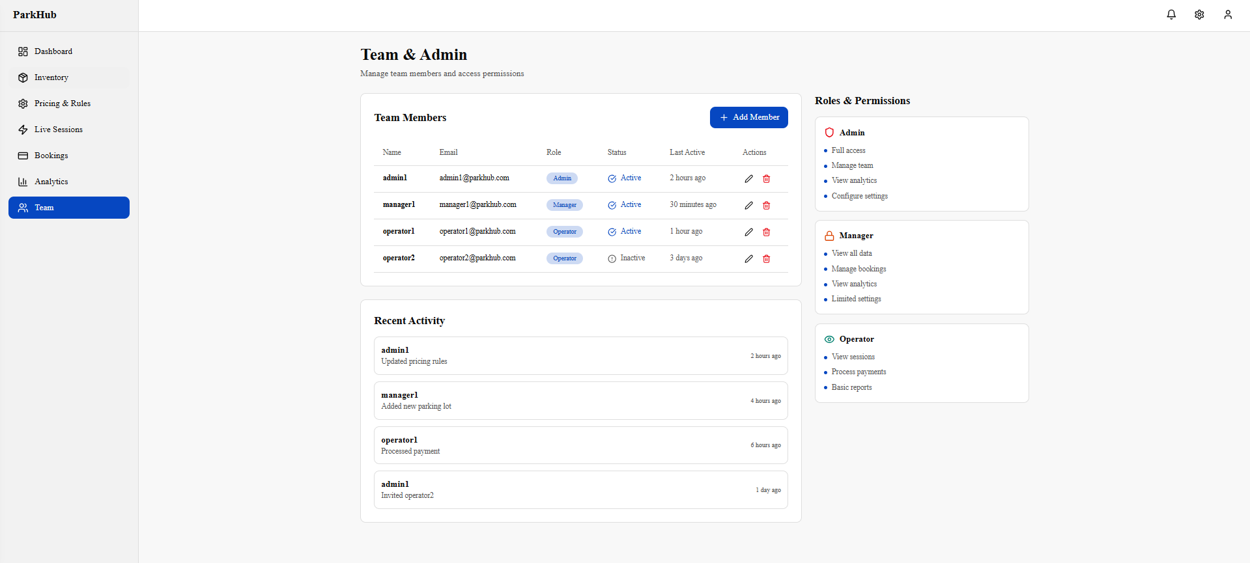
Mock – UI for Provider Web Application

Slide 8
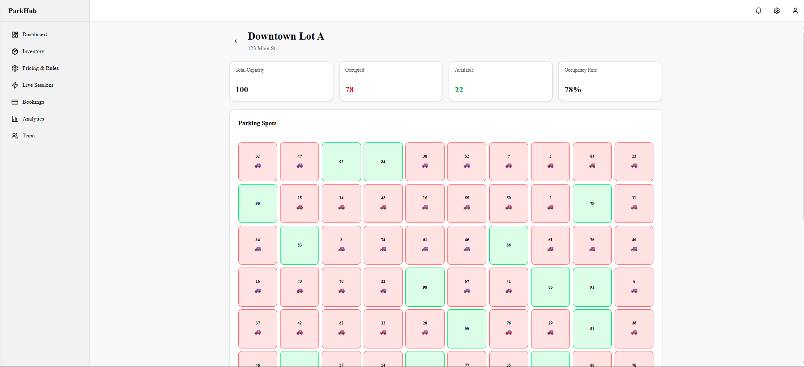
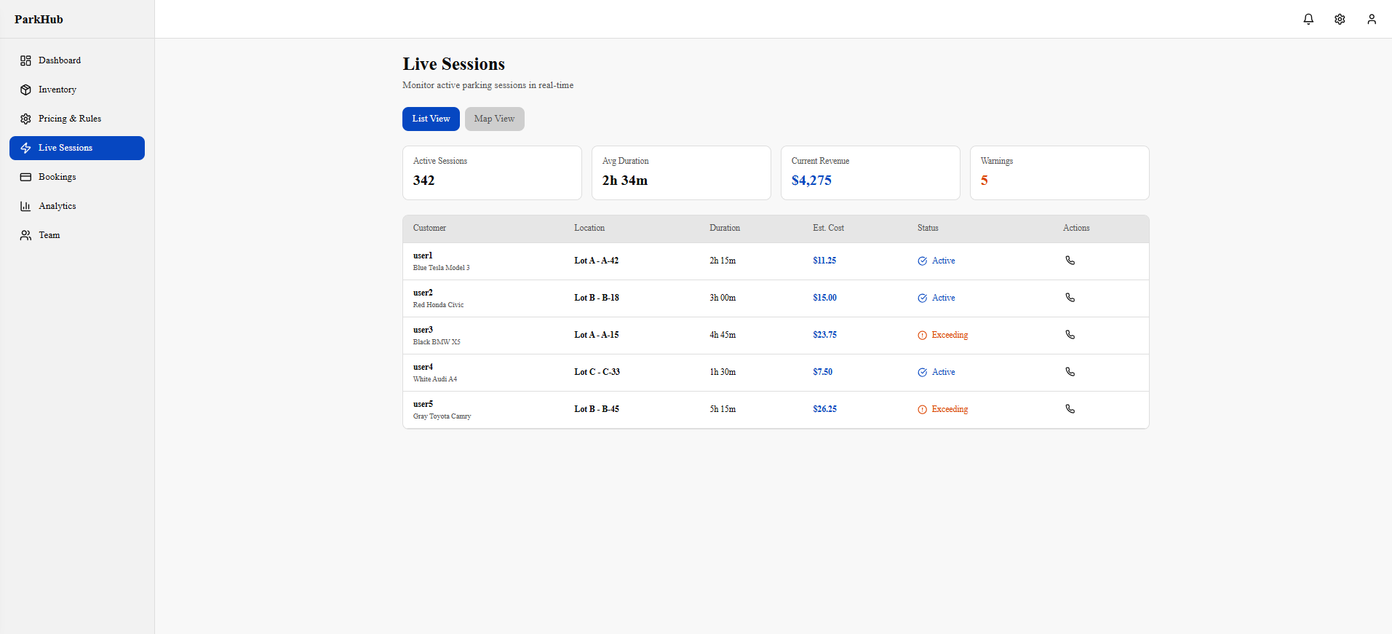
Mock – UI for Provider Web Application

Slide 9
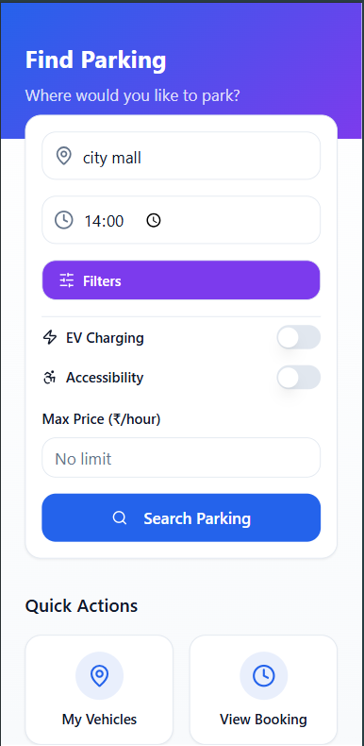
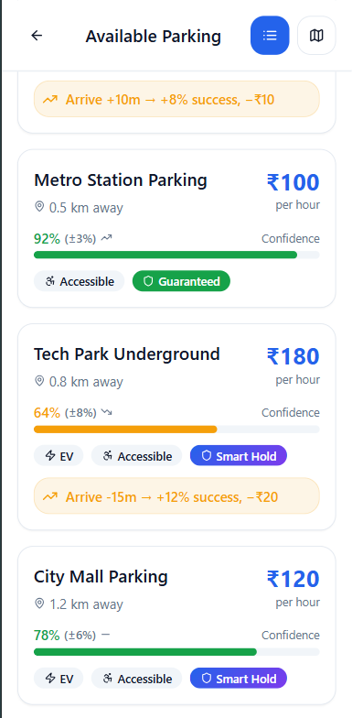
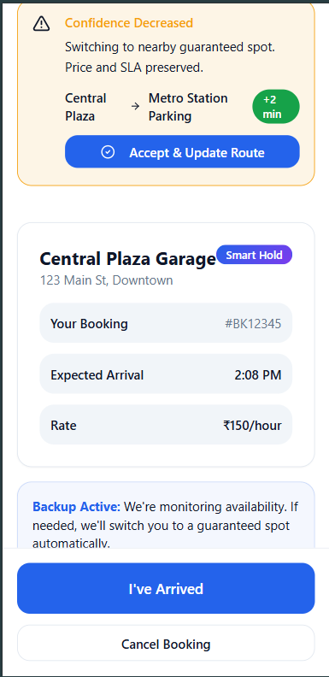
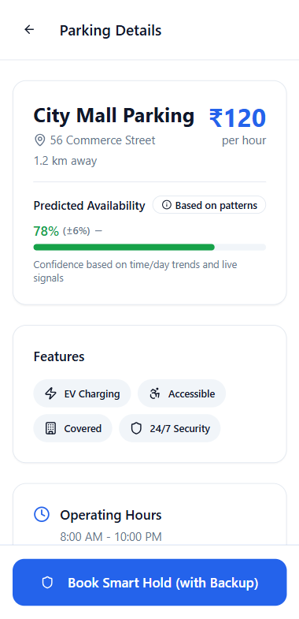
Mock – UI of Users(car-owners) Mobile App

Slide 10
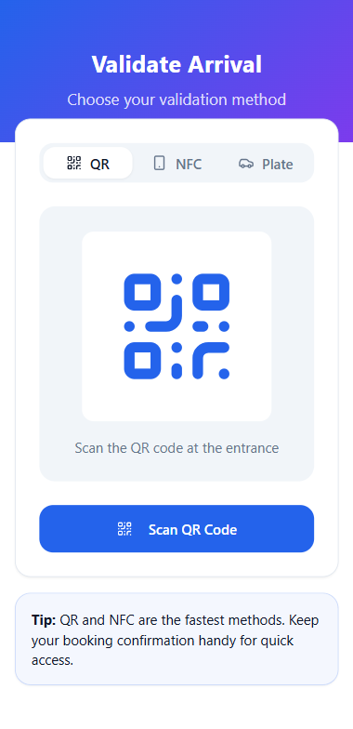
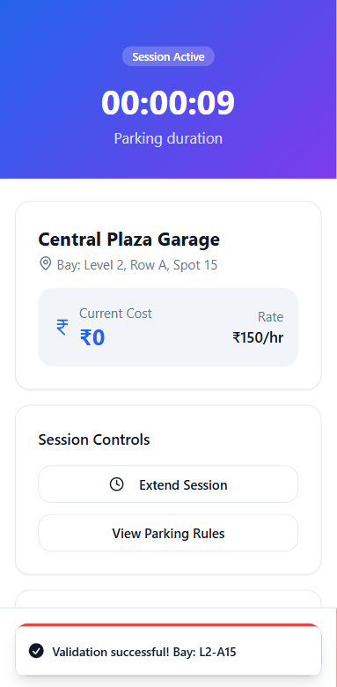
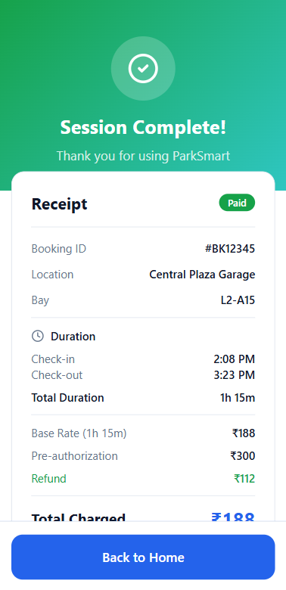
Mock – UI of Users(car-owners) Mobile App

Slide 11
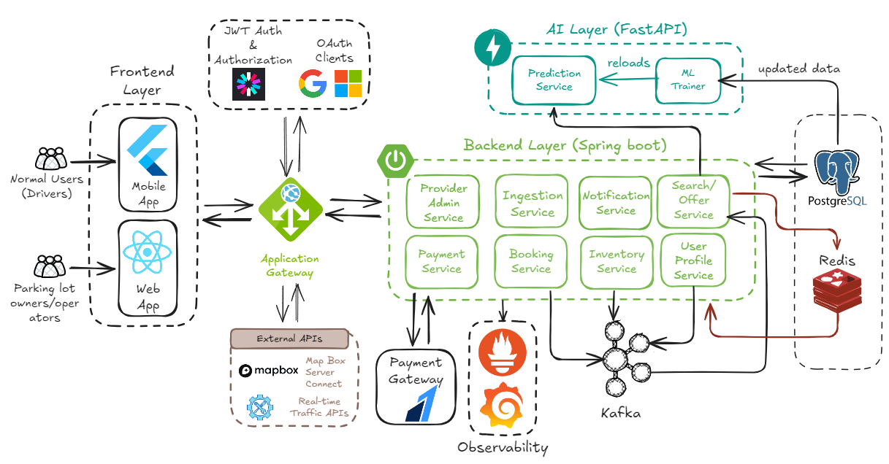
Architecture diagram of the proposed solution
The icons, logos, and trademarks used in this diagram are the property of their respective owners. They are included here for illustrative and educational purposes only to represent technologies, frameworks, or services conceptually. No endorsement, affiliation, or ownership is implied.

Slide 12








Technologies to be used in the solution
Flutter:
Cross-platform driver app for search, booking, validation, and receipts.
React.js:
Lightweight and interactive for provider web portal for onboarding, pricing, and live operations.
PostgreSQL/MySQL:
System of record with geospatial queries for nearby inventory.
Redis
Hot cache for availability, short-lived holds, sessions, and rate limits.
Spring boot:
Stateless microservices with secure API routing and rate limiting.
FastAPI (Python) + PyTorch/XGBoost
Real-time prediction API with offline training and hot-reload.
JWT/OAuth:
entralized authentication/authorization with roles and token issuance.
Kafka
Event backbone for bookings, payments, inventory updates, and telemetry.

Slide 13


Slide 14
What if parking felt as effortless as booking a cab? Our app is a predictive parking marketplace that shows you where a spot will be free at your ETA, lets you pre‑book it with confidence, and auto‑handles payments - so you just drive, park, and go.
How it works
      Prediction model: Uses a spatiotemporal ML model to estimate the likelihood a spot is free at arrival, with confidence levels.
      Smart ranking: Ranks parking offers by distance, price, and success probability; supports EV and accessibility filters.
      Booking logic: Lets users book guaranteed or cheaper “smart hold” spots, with an automatic backup if confidence is low.
      Seamless arrival: Entry via QR, NFC, or license plate; guided navigation ensures smooth final approach.
Why it works
Calibrated predictions: Replaces guesswork with reliable probabilities, showing users a trusted “chance of spot” instead of static pins.
Smart backup system: Automatically swaps to the best nearby spot if the first isn’t ready, backed by an SLA to reduce user anxiety.
Demand steering: Uses small time or price adjustments to balance demand, reduce cruising, and boost availability.
Learning loop: Continuously refines models using real outcomes (arrivals, overstays, no-shows) to boost accuracy, utilization, and revenue.
Brief about the idea

Slide 15
Opportunities – USP and “How It Solves” the problem
A spatiotemporal ML model forecasts block face availability for your exact arrival time and displays a calibrated probability with a confidence band (e.g., “86% ±5%”). It fuses live signals (ETA changes, bookings, events/weather, optional sensors) so users see trustworthy, latest availability.
Predictive Availability at ETA
Smart Hold & Automatic Backup‑Swap (Reliability)
Book with a lower‑cost Smart Hold or full Guarantee. The system pre‑auths payment, watches risk in transit, and proactively activates the best nearby backup if confidence drops - preserving price and SLA - so the journey remains reliable without over‑reserving inventory.
Hardware‑Lite Access & Fast Onboarding
Works day one with QR validation; plate and sensors are optional add‑ons. Providers self‑serve to publish locations, stalls, EV/accessible flags, pricing, and blackouts - going live in hours. Signals from devices/feeds can be ingested later to boost accuracy.
Demand Steering, EV/Accessibility & Seamless Payments
Subtle time/price nudges (e.g., arrive +10 min) raise success odds and smooth peaks; EV and accessibility filters are first‑class in every search. Payments are pre‑authorized at booking and automatically captured/refunded on exit, with instant receipts and clear status.
City‑Scale Performance & Continuous Learning
Fast geospatial search (PostGIS) and hot caching keep results snappy; event‑driven updates refresh availability within seconds. The ML loop retrains from real outcomes (arrivals, overstays, no‑shows) and hot‑reloads safely, while observability ensures stable operations as the network grows.

Slide 16
List of features offered by the solution
“Fast Search & Offers”
Real‑time discovery
Ranked nearby options with map + list, rich cards (price, distance, rules, EV/accessible), entrance info, and quick filters for time, price cap, and amenities.
“One‑Tap Booking & Payments”
Hold → confirm
Choose Guaranteed or Smart Hold, see clear price breakdown and policy, confirm with saved payment; pre‑auth status shown inline with friendly error recovery.
“Provider Console & Ops”
Self‑serve supply and insights
Onboard locations/stalls, set pricing/blackouts, monitor live sessions and bookings, and view utilization/revenue basics; changes reflect quickly in customer search.
“Session Control & Exit” Manage your stay
Live timer, extend stay, cost estimator, gentle overstay/grace alerts; end session to auto capture/refund and receive an itemized receipt instantly.
“Guided Arrival & Access”
Navigate and validate
Turn‑by‑turn to the correct entrance, arrival checklist, and hardware‑lite access via QR/NFC (plate entry fallback); bay/level guidance on success.
“Proactive Alerts & Support” Stay informed end‑to‑end
Clear notifications for confirmations, swap notices, reminders, and extension prompts; instant receipts and quick help.

